Slide 1
Chapter 9: Virtual Memory

Slide 2
Chapter 9: Virtual Memory
9.1 Background
9.2 Demand Paging
9.3 Copy-on-Write
9.4 Page Replacement
9.5 Allocation of Frames
9.6 Thrashing
9.7 Memory-Mapped Files
9.8 Allocating Kernel Memory
9.9 Other Considerations
9.10 Operating-System Examples
9.11 Summary

Slide 3
Objectives
To describe the benefits of a virtual memory system
To explain the concepts of demand paging, page-replacement algorithms, and allocation of page frames
To discuss the principle of the working-set model

Slide 4
9.1 Background

Slide 5
Background
Virtual Memory ： Only part of a running program needs to be loaded into memory for execution
Virtual memory separates user logical memory from physical memory
Logical (or virtual) address space can be larger than physical address space
Allows physical address space to be shared by several processes
Enables quicker process creation
What about fork()?
Virtual memory can be implemented via:
Demand paging （请求调页，按需调页，请求页式管理）
Demand segmentation（请求段式管理）

Slide 6
principle of locality
局部性原理(principle of locality)：指程序在执行过程中的一个较短时期，所执行的指令地址和指令的操作数地址，分别局限于一定区域。表现为：
时间局部性：一条指令的一次执行和下次执行，一个数据的一次访问和下次访问都集中在一个较短时期内；
空间局部性：当前指令和邻近的几条指令，当前访问的数据和邻近的数据都集中在一个较小区域内。
虚拟存储器是具有请求调入功能和置换功能，能仅把进程的一部分装入内存便可运行进程的存储管理系统，它能从逻辑上对内存容量进行扩充的一种虚拟的存储器系统

Slide 7
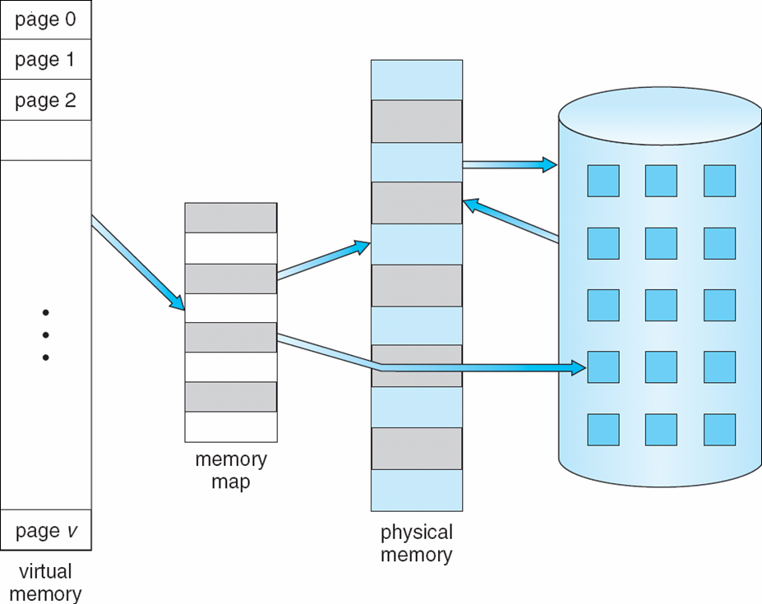
Virtual Memory That is Larger Than Physical Memory
⇒

Slide 8
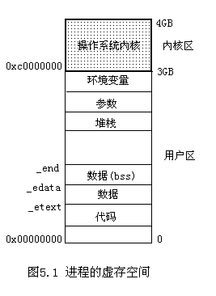
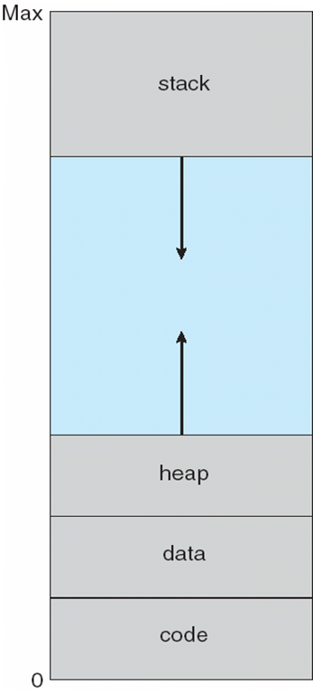
Virtual-address Space（虚拟地址空间）

Slide 9
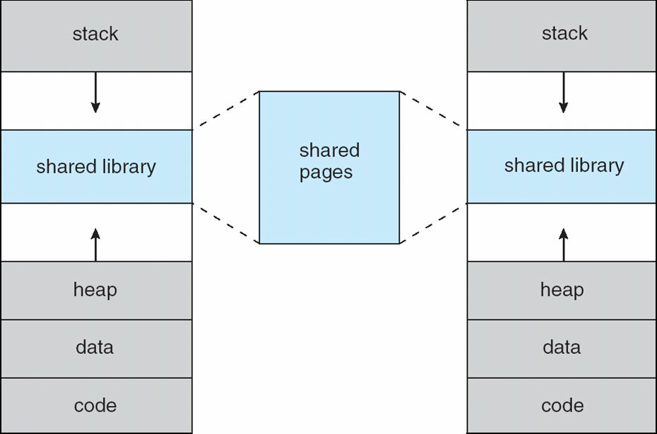
Shared Library Using Virtual Memory

Slide 10
9.2 Demand Paging（按需调页、请求调页）

Slide 11
Demand Paging
Bring a page into memory only when it is needed
Less I/O needed
Less memory needed
Faster response
More users
Page is needed ⇒ reference to it
invalid reference ⇒ abort
not-in-memory ⇒ bring to memory
Lazy swapper – never swaps a page into memory unless page will be needed
Swapper that deals with pages is a pager

Slide 12
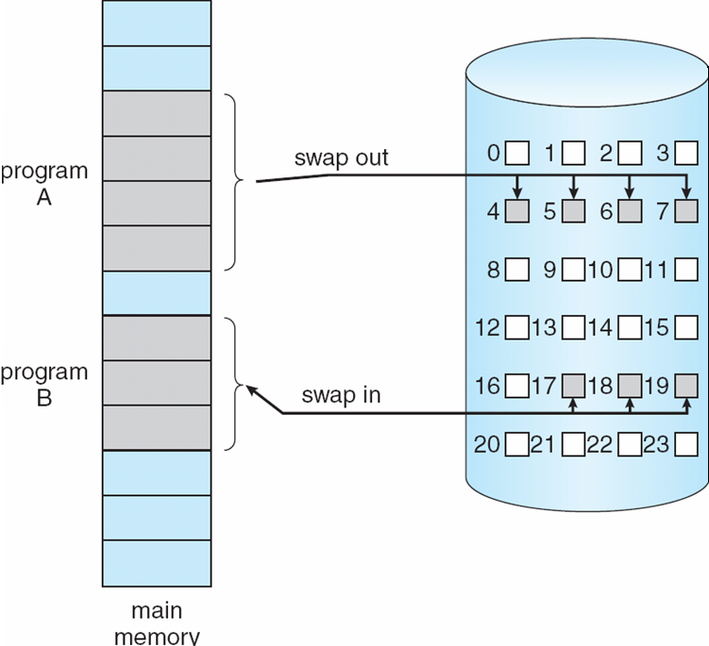
Transfer of a Paged Memory to Contiguous Disk Space

Slide 13
Valid-Invalid Bit
With each page table entry a valid–invalid bit is associated (v ⇒ in-memory, i ⇒ not-in-memory)
Initially valid–invalid bit is set to i on all entries
Example of a page table snapshot:
During address translation, if valid–invalid bit in page table entry
is i ⇒ page fault
Frame#
valid-invalid bit
v
v
i
v
page table
v
….
i
i

Slide 14
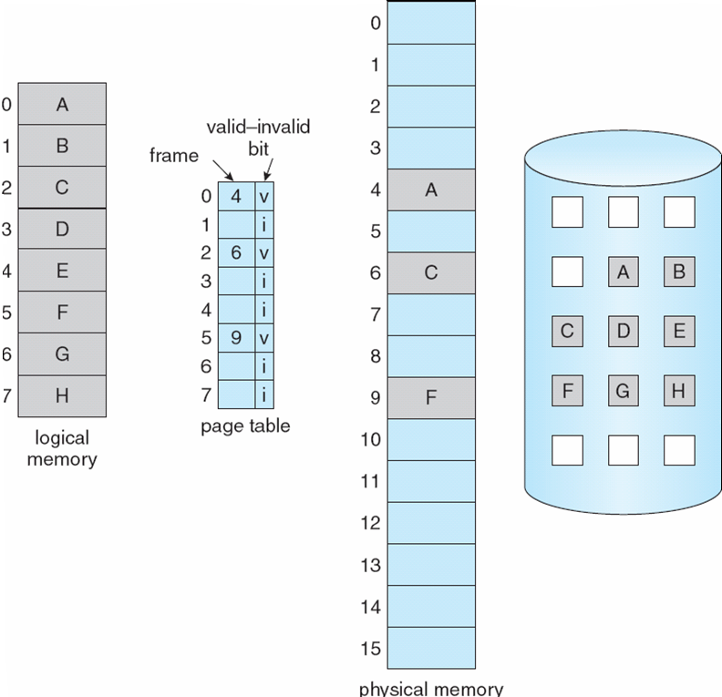
Page Table When Some Pages Are Not in Main Memory

Slide 15
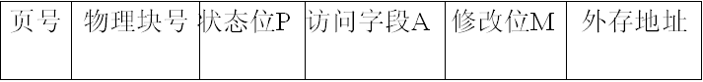
更完整的页表
在请求分页系统中的每个页表项如图所示：
状态位P（存在位）：用于指示该页是否已调入内存，供程序访问时参考。
访问字段A：用于记录本页在一段时间内被访问的次数，或最近已有多长时间未被访问，提供给置换算法选择换出页时参考。
修改位R/W：表示该页在调入内存后是否被修改过。
外存地址：用于指出该页在外存上的地址，供调入该页时使用。

Slide 16
Page Fault（缺页）
If there is a reference to a page, first reference to that page will trap to operating system:
page fault
Operating system looks at another table to decide:
Invalid reference ⇒ abort（非法地址访问）
Just not in memory
Get empty frame
Swap page into frame
Reset tables
Set validation bit = v
Restart the instruction that caused the page fault

Slide 17

Steps in Handling a Page Fault

Slide 18

Demand Paging Performance
The page fault rate p is in the range [0.0, 1.0]:
If p is 0.0, no page faults at all
If p is 1.0, every page is a page fault
Typically p is very low....
The effective memory-access time is
(1 – p) x physical-memory-access + p x ( page-fault-overhead + swap-page-out + swap-page-in + restart-overhead )
page-fault service time

Slide 19
Performance of Demand Paging
To compute the EAT, we must know how much time is needed to service a page fault. A page fault causes the following sequence to occur:
Trap to the OS.
Save the user registers and process state.
Determine that the interrupt was a page fault.
Check that the page reference was legal and determine the location of the page on the disk.
Issue a read from the disk to a free frame:
Wait in a queue for this device until the read request is serviced.
Wait for the device seek time and latency time.
Begin the transfer of the page to a free frame.

Slide 20
Performance of Demand Paging
While waiting, allocate the CPU to some other user (CPU scheduling, optional).
Interrupt from the disk (I/O completed).
Save the registers and process state for the other user (if step 6 is executed).
Determine that the interrupt was from the disk.
Correct the page table and other tables to show that the desired page is now in memory.
Wait for the CPU to be allocated to this process again.
Restore the user registers, process state, and new page table, then resume the interrupt instruction.

Slide 21
Performance of Demand Paging
Three major components of the page-fault service time
Service the page-fault interrupt(缺页中断服务时间)
Read in the page(将缺页读入时间)
Restart the process(重新启动进程时间)

Slide 22
Demand Paging Example
Memory access time = 200 nanoseconds（ns）
Average page-fault service time = 8 milliseconds（ms）
EAT = (1 – p) x 200 ns + p x8 ms
= (1 – p) x 200 ns + p x 8,000,000 ns
= 200 + p x 7,999,800 ns
If one access out of 1,000 causes a page fault（p=0.001）, then
EAT = 8200 ns
This is a slowdown by a factor of 40!!
microsecond--us

Slide 23
9.3 Process Creation

Slide 24

Process Creation
Virtual memory allows other benefits during process creation:
Copy-on-Write（写时拷贝）

Slide 25
Copy-on-Write
Copy-on-Write (COW) allows both parent and child processes to initially share the same pages in memory If either process modifies a shared page, only then is the page copied
COW allows more efficient process creation as only modified pages are copied
Free pages are allocated from a pool of zeroed-out pages
Windows、Linux、Solaris

Slide 26
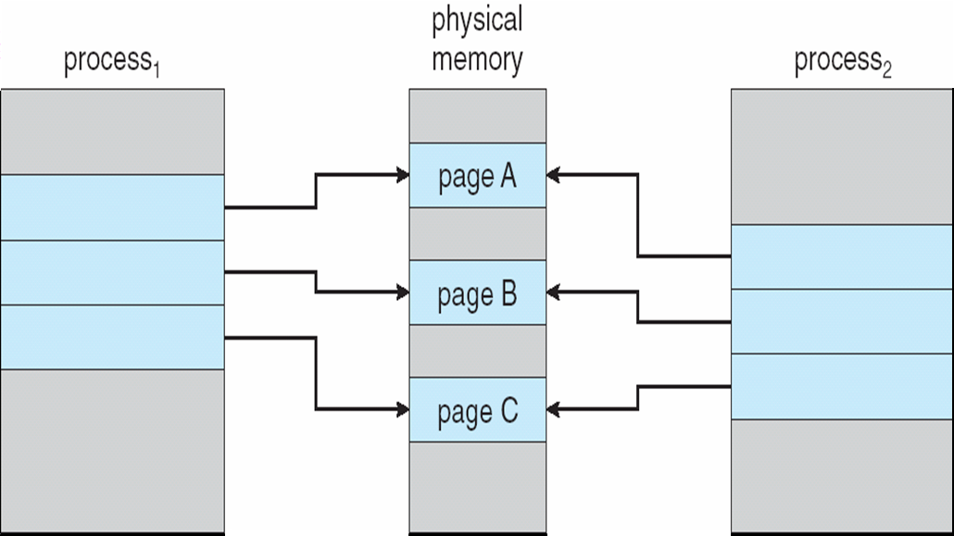
Before Process 1 Modifies Page C

Slide 27
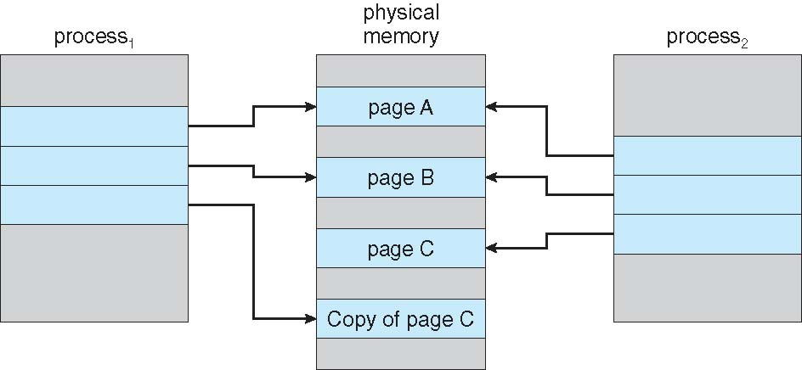
After Process 1 Modifies Page C

Slide 28
9.4 Page Replacement （页面置换）

Slide 29
What happens if there is no free frame?
Page Replacement 页面置换
Page replacement – find some page in memory, but not really in use, swap it out
algorithm
performance – want an algorithm which will result in minimum number of page faults
Same page may be brought into memory several times

Slide 30
Page Replacement
Prevent over-allocation of memory by modifying page-fault service routine to include page replacement
Use modify (dirty) bit to reduce overhead of page transfers – only modified pages are written to disk
Page replacement completes separation between logical memory and physical memory – large virtual memory can be provided on a smaller physical memory

Slide 31
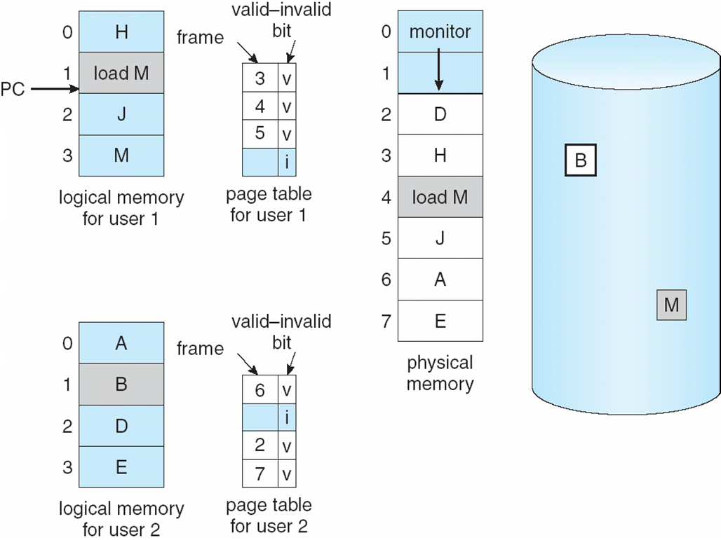
Need For Page Replacement

Slide 32
Basic Page Replacement
页面置换的过程：
Find the location of the desired page on disk
Find a free frame: - If there is a free frame, use it - If there is no free frame, use a page replacement algorithm to select a victim (淘汰) frame - Write the victim page to the disk; change the page and frame tables accordingly.
Bring the desired page into the (newly) free frame; update the page and frame tables
Restart the process

Slide 33
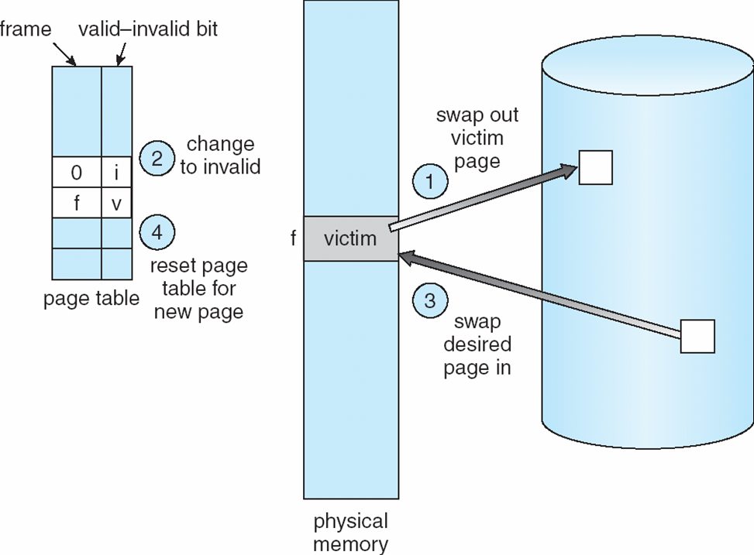
Page Replacement

Slide 34
Page Replacement Algorithms
Want lowest page-fault rate
Evaluate algorithm by running it on a particular string of memory references (reference string，引用串) and computing the number of page faults on that string
reference string:(100 bytes per page)
0100, 0432,0101,0612, 0102,0103,0104,0611,0120 ➔ 1,4,1,6,1,6,1
In all our examples, the reference string is
1, 2, 3, 4, 1, 2, 5, 1, 2, 3, 4, 5
7,0,1,2,0,3,0,4,2,3,0,3,2,1,2,0,1,7,0,1.、

Slide 35
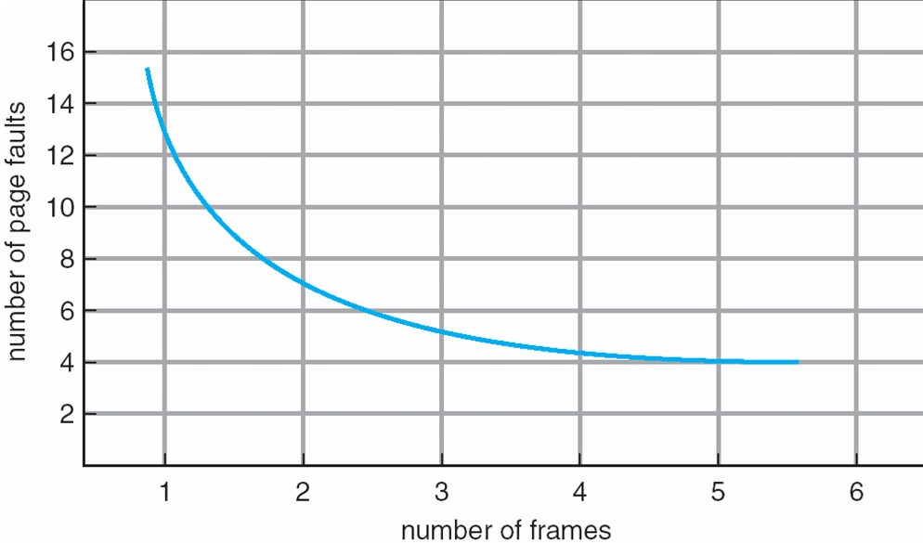
Graph of Page Faults Versus The Number of Frames

Slide 36
Page Replacement Algorithms
First-In-First-Out Algorithm (FIFO，先进先出算法)
Optimal Algorithm （OPT 最佳页面置换算法）
Least Recently Used (LRU) Algorithm (最近最久使用算法)
LRU Approximation Algorithms （近似LRU算法） ：
Additional-Reference-Bits Algorithm
Second-Chance（clock） Algorithm
Enhanced Second-Chance Algorithm
Counting-Base Page Replacement：
Least Frequently Used Algorithm (LFU最不经常使用算法）
Most Frequently Used Algorithm (MFU引用最多算法)
Page Buffering Algorithm（页面缓冲算法）

Slide 37
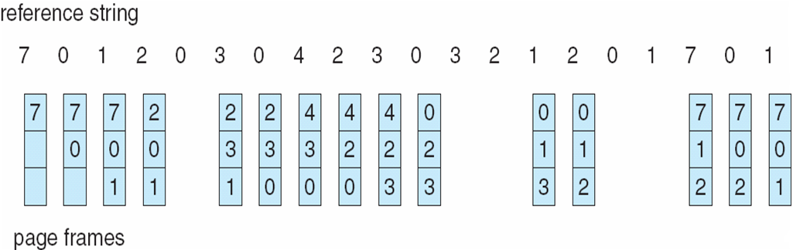
FIFO Page Replacement
How many page faults occur?
15 Page faults

Slide 38
First-In-First-Out (FIFO) Algorithm
Reference string: 1, 2, 3, 4, 1, 2, 5, 1, 2, 3, 4, 5
3 frames (3 pages can be in memory at a time per process)
4 frames
Belady’s Anomaly: more frames ⇒ more page faults
1
1
4
5
2
2
1
3
9 page faults
3
3
2
4
1
1
5
4
2
2
1
5
10 page faults
3
3
2
4
4
3

Slide 39
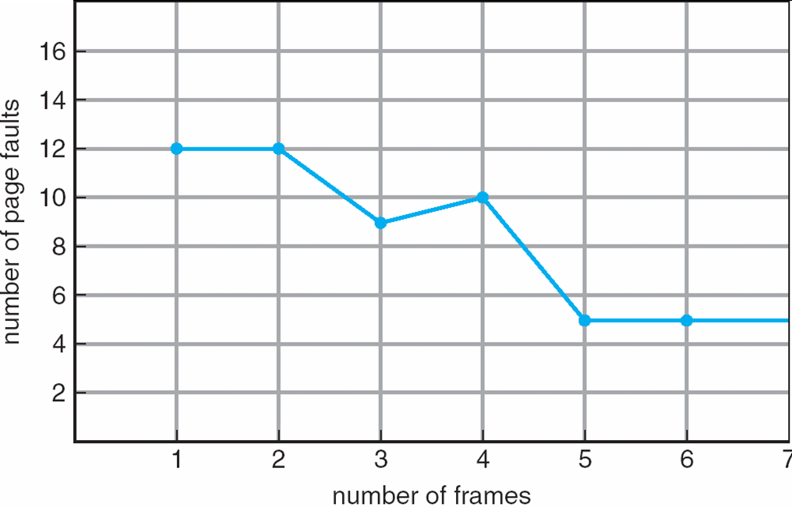
FIFO Illustrating Belady’s Anomaly

Slide 40
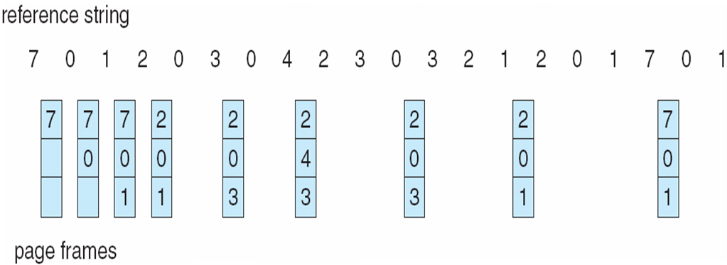
Optimal Page Replacement
OPT(最佳页面置换算法)：Replace page that will not be used for longest period of time。选择“未来不再使用的”或“在离当前最远位置上出现的”页被置换。
How do you know this?
Used for measuring how well your algorithm performs
9 Page faults

Slide 41
Optimal Algorithm
4 frames example
1, 2, 3, 4, 1, 2, 5, 1, 2, 3, 4, 5
1
4
2
6 page faults
3
4
5

Slide 42
Least Recently Used (LRU) (最近最久使用) Algorithm
LRU(最近最少使用算法)：选择内存中最久没有引用的页面被置换。这是局部性原理的合理近似，性能接近最佳算法。但由于需要记录页面使用时间，硬件开销太大。
Reference string: 1, 2, 3, 4, 1, 2, 5, 1, 2, 3, 4, 5
1
1
1
1
5
2
2
2
2
2
3
5
5
4
4
8 Page faults
4
4
3
3
3

Slide 43
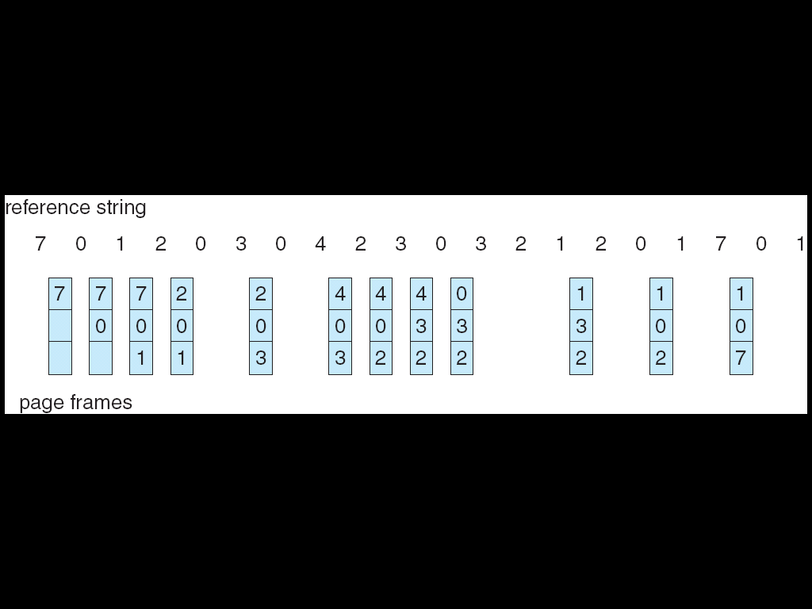
LRU Page Replacement
12 Page faults

Slide 44
LRU算法 ,如何获知“多长时间没引用”？
Counter implementation
Every page entry has a counter; every time page is referenced through this entry, copy the clock into the counter
When a page needs to be changed, look at the counters to determine which are to change
Stack implementation – keep a stack of page numbers in a double link form:
Page referenced:
move it to the top
requires 6 pointers to be changed
No search for replacement

Slide 45
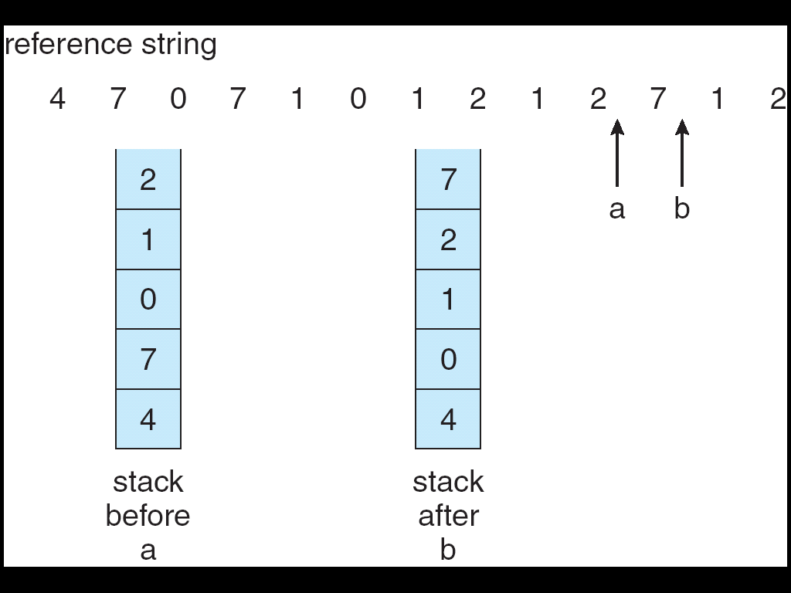
Use Of A Stack to Record The Most Recent Page References

Slide 46
LRU Approximation Algorithms
Reference bit
With each page table entry associate a bit, initially = 0
When page is referenced bit set to 1
Replace the one which is 0 (if one exists)
We do not know the order, however
31
12
6
5
2
1
0
页帧的物理地址，第31位至第12位
D
A
U/S
R/W
P

Slide 47
1. Additional-Reference-Bits Algorithm
附加引用位算法：
To keep an 8-bit byte for each page in a table in memory
At regular intervals (every 100 ms), a timer interrupt transfers control to the OS. The OS shifts the reference bit for each page into the high-order bit of its 8-bit byte, shifting the other bits right 1 bit, discarding the low-order bit. These 8-bit bytes contain the history of the page use for the last eight time periods.
If we interpret these 8-bit bytes as unsigned integers, the page with the lowest number is the LRU page and it can be replaced.
被访问时左边最高位置1，定期右移并且最高位补0，于是寄存器数值最小的是最久未使用页面。

Slide 48
2. Second-Chance (clock) Algorithm
Second chance(clock算法)
Need reference bit
Clock replacement
If page to be replaced (in clock order) has reference bit = 1 then:
set reference bit 0
leave page in memory
replace next page (in clock order), subject to same rules

Slide 49
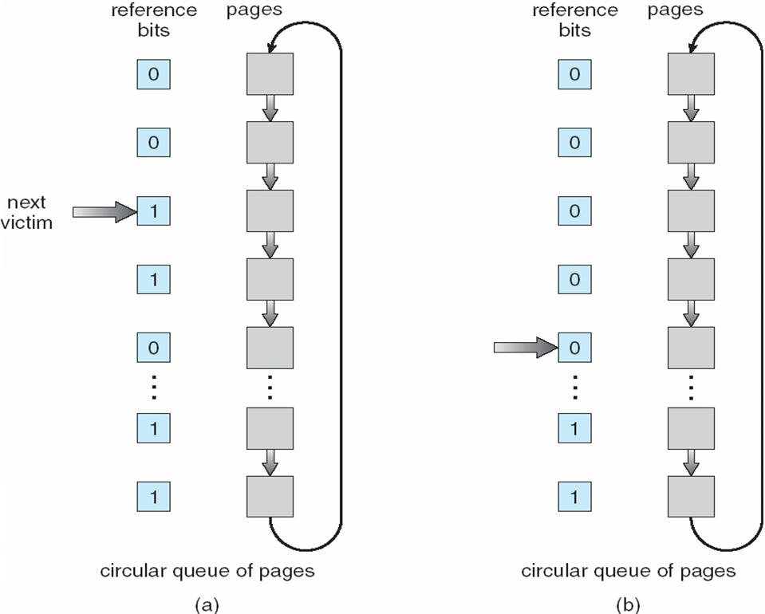
Second-Chance Page-Replacement Algorithm

Slide 50
3. Enhanced Second-Chance Algorithm
增强二次机会算法（改进型的clock算法）
使用引用位和修改位：引用过或修改过置成1
(Reference bit, modified bit) ：
(0,0): best page to replace
(0,1): not quite good for replacement
(1,0): will be used soon
(1,1): worst page to replace.
淘汰次序：(0,0) ⇒(0,1)⇒(1,0)⇒(1,1)
Macintosh系统中使用

Slide 51
Counting Algorithms
Keep a counter of the number of references that have been made to each page
LFU(Least Frequently Used) Algorithm(最不经常使用算法): replaces page with smallest count
MFU(Most Frequently Used) Algorithm(经常使用算法): based on the argument that the page with the smallest count was probably just brought in and has yet to be used

Slide 52
Page Buffering Algorithm页面缓冲算法
页面缓冲算法: 通过被置换页面的缓冲，有机会找回刚被置换的页面
被置换页面的选择和处理：用FIFO算法选择被置换页，把被置换的页面放入两个链表之一。即：如果页面未被修改，就将其归入到空闲页面链表的末尾，否则将其归入到已修改页面链表。
需要调入新的页面时，将新页面内容读入到空闲页面链表的第一项所指的页面，然后将第一项删除。
空闲页面和已修改页面，仍停留在内存中一段时间，如果这些页面被再次访问，这些页面还在内存中。
当已修改页面达到一定数目后，再将它们一起调出到外存，然后将它们归入空闲页面链表。
VAX/VMS系统使用
Windows、Linux页面置换算法是基于页面缓冲算法。

Slide 53
9.5 Allocation of Frames(帧分配)

Slide 54
Allocation of Frames(帧分配)
Each process needs minimum number of pages
Example: IBM 370 – 6 pages to handle SS MOVE instruction:
instruction is 6 bytes, might span 2 pages
2 pages to handle from
2 pages to handle to
Two major allocation schemes
fixed allocation
priority allocation

Slide 55
Fixed Allocation（固定分配）
Equal allocation（平均分配算法） – For example, if there are 100 frames and 5 processes, give each process 20 frames.
Proportional allocation （按比例分配算法） – Allocate according to the size of process

Slide 56
Priority Allocation（优先级分配）
Use a proportional allocation scheme using priorities rather than size
If process P_{i} generates a page fault,
select for replacement one of its frames
select for replacement a frame from a process with lower priority number

Slide 57
Global vs. Local Allocation
置换策略：
Global replacement（全局置换） – process selects a replacement frame from the set of all frames; one process can take a frame from another
Local replacement （局部置换）– each process selects from only its own set of allocated frames
分配策略：
固定分配
可变分配

Slide 58
帧的分配和置换策略
组合成三种策略：
固定分配局部置换策略
可变分配全局置换策略
可变分配局部置换策略

Slide 59
9.6 Thrashing （颠簸、抖动）

Slide 60

Thrashing （颠簸、抖动）
If a process does not have “enough” pages, the page-fault rate is very high. This leads to:
很低的CPU利用率
误导OS以为有必要提高多任务的程度
误导OS装入更多作业，内存中驻留更多进程
于是，每个进程拥有的页帧数更少
如此恶性循环，会怎样 ？
Thrashing ≡ a process is busy swapping pages in and out

Slide 61
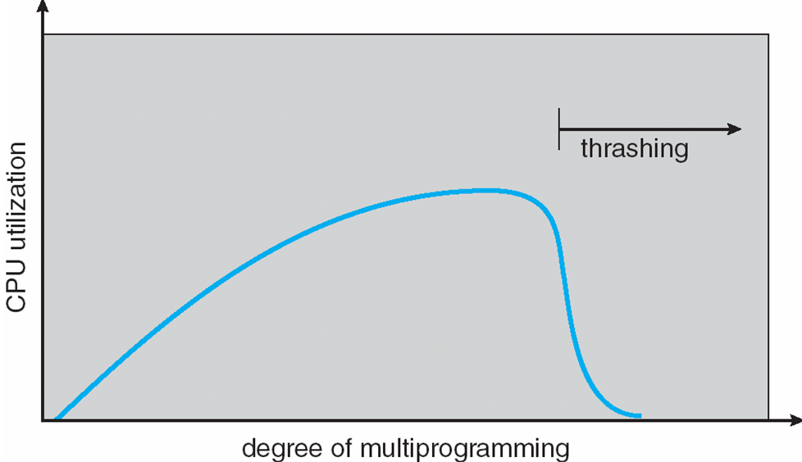
Thrashing (Cont.)

Slide 62
Demand Paging and Thrashing
Why does demand paging work? Locality（局部性） model
Process migrates from one locality to another
Localities may overlap
Why does thrashing occur? Σ size of locality > total memory size

Slide 63
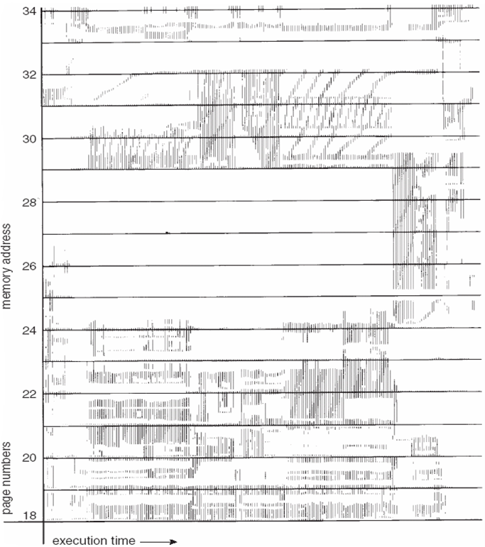
Locality In A Memory-Reference Pattern
局部性原理：时间局部性和空间局部性

Slide 64
Working-Set Model
working set (WS)工作集：The set of pages in the most recent Δ page references
Δ ≡ working-set window(工作集窗口) ≡ a fixed number of page references Example: 10,000 instruction
WSS_{i} (working set size of Process P_{i} 工作集大小) = total number of pages referenced in the most recent Δ (varies in time)
if Δ too small will not encompass entire locality.
if Δ too large will encompass several localities.
if Δ = ∞ ⇒ will encompass entire program.
D = Σ WSS_{i} ≡ total demand frames; m ≡ total available frames
if D > m ⇒ Thrashing
Policy if D > m, then suspend one of the processes.

Slide 65
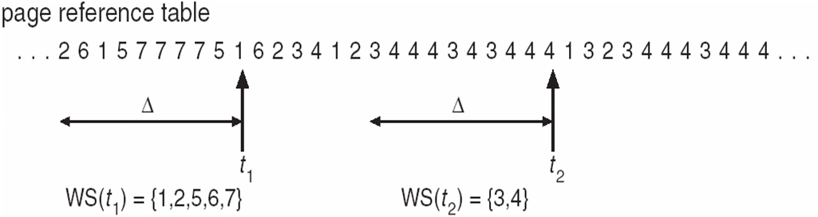
Working-set model
WSS=5
WSS=2

Slide 66
Keeping Track of the Working Set
Approximate with interval timer + a reference bit
Example: Δ = 10,000
Timer interrupts after every 5000 time units
Keep in memory 2 bits for each page
Whenever a timer interrupts copy and sets the values of all reference bits to 0
If one of the bits in memory = 1 ⇒ page in working set
Why is this not completely accurate?
Improvement = 10 bits and interrupt every 1000 time units

Slide 67
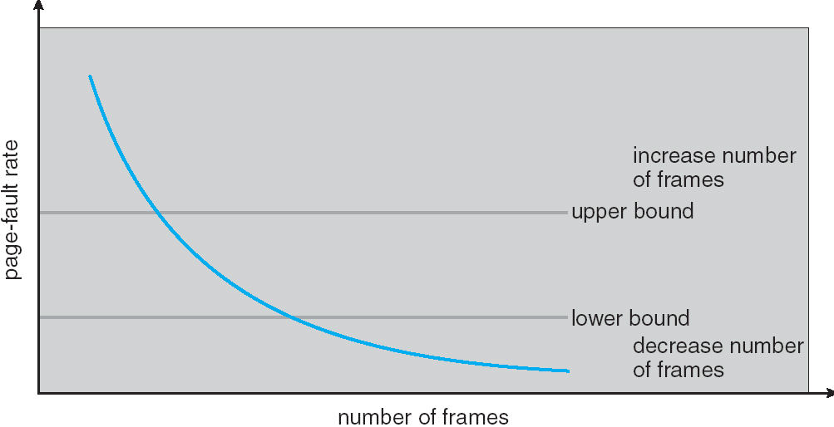
Page-Fault Frequency Scheme（缺页频率）
Establish “acceptable” page-fault rate
If actual rate too low, process loses frame
If actual rate too high, process gains frame

Slide 68
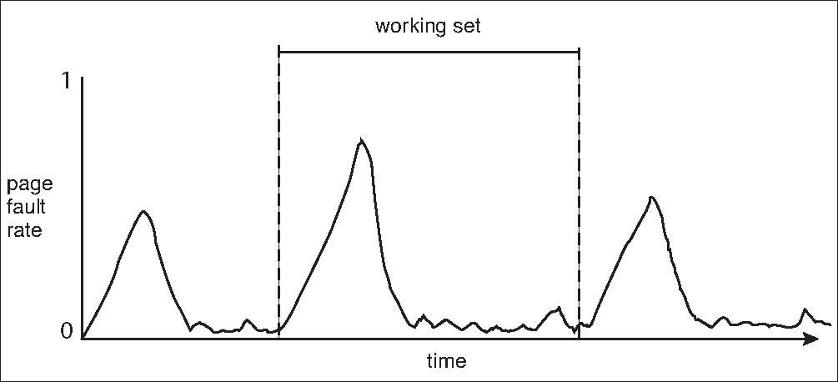
Working Sets and Page Fault Rates

Slide 69
9.7 Memory-Mapped Files

Slide 70
Memory-Mapped Files
Memory-mapped file I/O allows file I/O to be treated as routine memory access by mapping a disk block to a page in memory
A file is initially read using demand paging. A page-sized portion of the file is read from the file system into a physical page. Subsequent reads/writes to/from the file are treated as ordinary memory accesses.
Simplifies file access by treating file I/O through memory rather than read() write() system calls
Also allows several processes to map the same file allowing the pages in memory to be shared

Slide 71
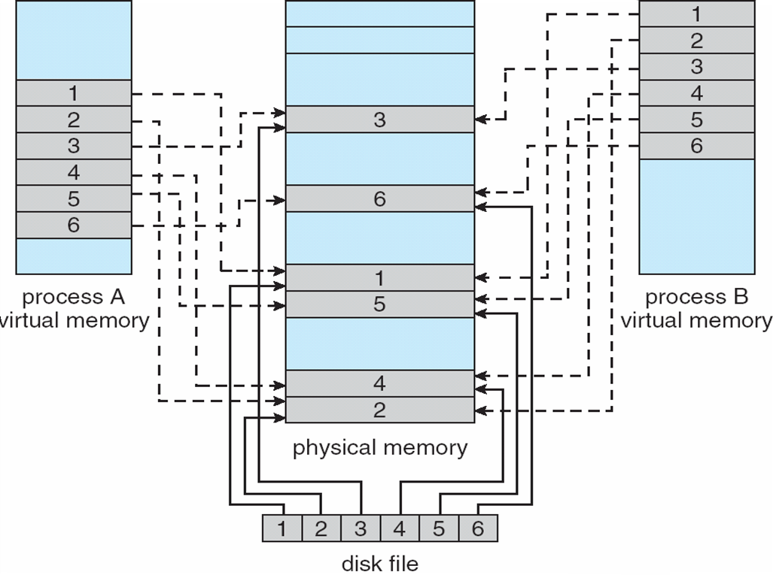
Memory Mapped Files

Slide 72
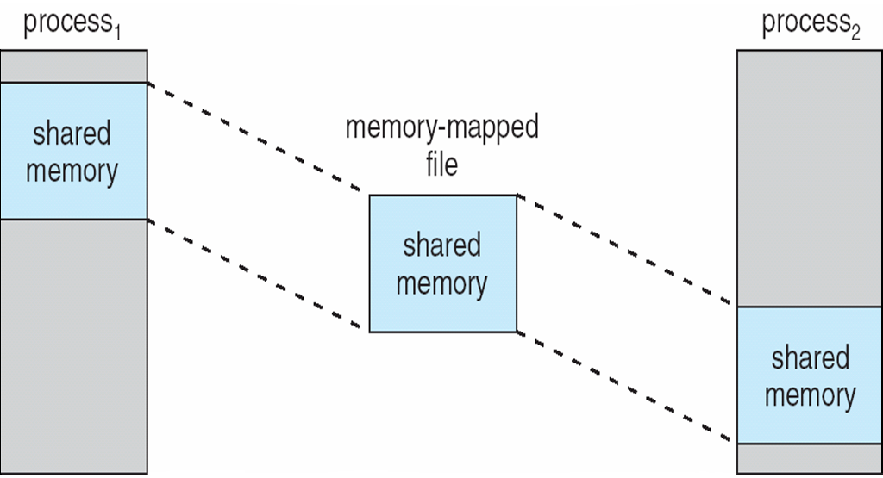
Memory-Mapped Shared Memory in Windows

Slide 73
9.8 Allocating Kernel Memory

Slide 74
Allocating Kernel Memory
Treated differently from user memory
Often allocated from a free-memory pool
Kernel requests memory for structures of varying sizes
Some kernel memory needs to be contiguous

Slide 75
Buddy System
Allocates memory from fixed-size segment consisting of physically-contiguous pages
Memory allocated using power-of-2 allocator
Satisfies requests in units sized as power of 2
Request rounded up to next highest power of 2
When smaller allocation needed than is available, current chunk split into two buddies of next-lower power of 2
Continue until appropriate sized chunk available

Slide 76
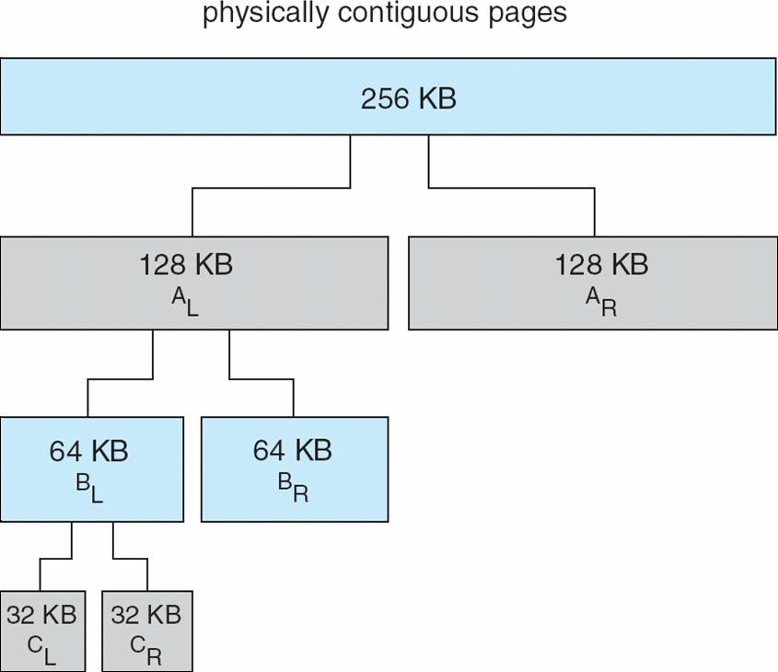
Buddy System Allocator

Slide 77
Slab Allocator
Alternate strategy
Slab is one or more physically contiguous pages
Cache consists of one or more slabs
Single cache for each unique kernel data structure
Each cache filled with objects – instantiations of the data structure
When cache created, filled with objects marked as free
When structures stored, objects marked as used
If slab is full of used objects, next object allocated from empty slab
If no empty slabs, new slab allocated
Benefits include no fragmentation, fast memory request satisfaction

Slide 78
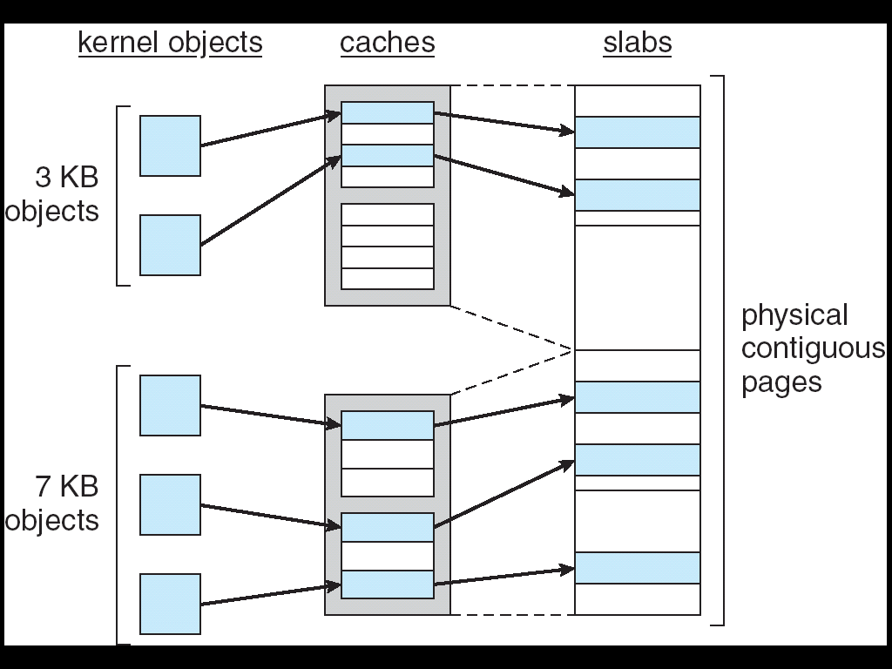
Slab Allocation

Slide 79
9.9 Other Considerations

Slide 80
Other Considerations
Prepaging （预调页）
Page Size（页大小）
TLB Reach（TLB范围）
Program Structure （程序结构）
I/O interlock（ I/O 锁定）

Slide 81
Other Issues -- Prepaging （预调页）
Prepaging
To reduce the large number of page faults that occurs at process startup
Prepage all or some of the pages a process will need, before they are referenced
But if prepaged pages are unused, I/O and memory was wasted
Assume s pages are prepaged and α of the pages is used
Is cost of s * α save pages faults > or < than the cost of prepaging s * (1- α) unnecessary pages?
α near zero ⇒ prepaging loses

Slide 82
Other Issues – Page Size （页大小）
Page size selection must take into consideration:
fragmentation
table size
I/O overhead
Locality
Increase the Page Size
This may lead to an increase in fragmentation as not all applications require a large page size
Provide Multiple Page Sizes
This allows applications that require larger page sizes the opportunity to use them without an increase in fragmentation

Slide 83
Other Issues – TLB Reach（TLB范围）
TLB Reach - The amount of memory accessible from the TLB
TLB Reach = (TLB Size) X (Page Size)
Ideally, the working set of each process is stored in the TLB
Otherwise there is a high degree of page faults

Slide 84
Other Issues – Program Structure
Program structure
int[128,128] data;
Each row is stored in one page
Program 1
for (j = 0; j <128; j++) for (i = 0; i < 128; i++) data[i,j] = 0;
128 x 128 = 16,384 page faults
Program 2
for (i = 0; i < 128; i++) for (j = 0; j < 128; j++) data[i,j] = 0;
128 page faults
Which method should you program?

Slide 85
Other Issues – I/O interlock
I/O Interlock – Pages must sometimes be locked into memory
Consider I/O - Pages that are used for copying a file from a device must be locked from being selected for eviction by a page replacement algorithm

Slide 86
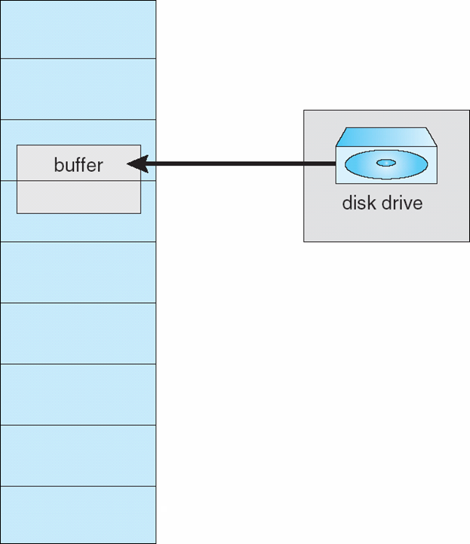
Reason Why Frames Used For I/O Must Be In Memory

Slide 87
9.10 Operating System Examples

Slide 88
Operating System Examples
Windows XP
Solaris

Slide 89
Windows XP
Uses demand paging with clustering. Clustering brings in pages surrounding the faulting page
Processes are assigned working set minimum and working set maximum
Working set minimum is the minimum number of pages the process is guaranteed to have in memory
A process may be assigned as many pages up to its working set maximum
When the amount of free memory in the system falls below a threshold, automatic working set trimming is performed to restore the amount of free memory
Working set trimming removes pages from processes that have pages in excess of their working set minimum

Slide 90
Solaris
Maintains a list of free pages to assign faulting processes
Lotsfree – threshold parameter (amount of free memory) to begin paging
Desfree – threshold parameter to increasing paging
Minfree – threshold parameter to being swapping
Paging is performed by pageout process
Pageout scans pages using modified clock algorithm
Scanrate is the rate at which pages are scanned. This ranges from slowscan to fastscan
Pageout is called more frequently depending upon the amount of free memory available

Slide 91
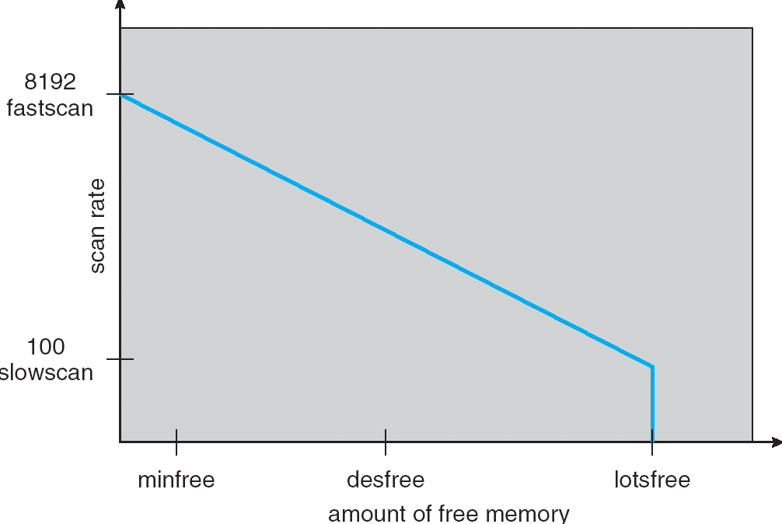
Solaris 2 Page Scanner

Slide 92
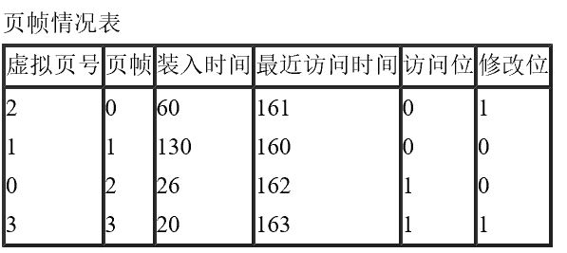
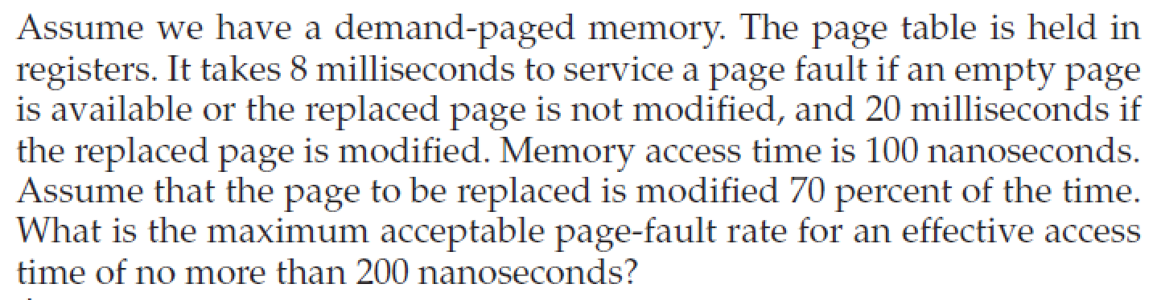
课堂练习
一进程已分配4个页帧（page frame），如下表所示（所有数字都为10进制数，且以0开始）。当进程访问第4页时，产生缺页中断，请分别用FIFO（先进先出）、LRU（最近最少使用）、增强二次机会算法，决定缺页中断服务程序选择换出的页面。

Slide 93
End of Chapter 9

